Slide 1



Slide 2
Sr No. | Product | Product Name
1 | PGR 2ML
2 | PGR (GIB)/5ML | EXTRA POWER
3 | PGR (6BA)/5ML | DOUBLE POWER
4 | PGR (GIB)/10ML DONGLE PACK | DOUBLE POWER
5 | PGR (6BA)/10ML DONGLE PACK | MAGIC 6BA
6 | PGR (6BA)/10ML | MAGIC POWER
7 | PGR (GIB)/10ML | MAGIC ZIB
8 | MIX MICRONUTRIENTS | NUTRIKING
9 | FUNGICIDE | FUNGIKING
10 | VIRICIDE | KING V-GRUARD
11 | LARVICIDE | LARVAKING
12 | MITYCIDE | CAPTAIN
13 | ALL SUCKING PEST | COMMANDO
14 | BORER SPECIAL LARVICIDE | SHOOTER
15 | ALL TYPES OF LARVA

Slide 3
Founded with a vision to provide effective, eco-friendly agrochemical solutions, King Agro Chemicals has grown to become a trusted name in the industry. Based in Rajkot, Gujarat, we specialize in manufacturing PGR products, pesticides, and bio-pesticides that meet the highest standards of quality and sustainability. Our products are designed to meet the diverse needs of farmers, ensuring improved crop protection, higher yields, and reduced environmental impact. We take pride in our research and development capabilities, continuously improving our products to cater to the evolving needs of the agriculture sector.
Our Mission
To empower farmers with sustainable and innovative agricultural solutions, ensuring their crops are healthy, productive, and protected against pests and diseases.
Our Vision
To become the leading provider of eco-friendly agrochemicals, delivering high-quality products that support sustainable farming and contribute to the growth of agriculture.

Slide 4
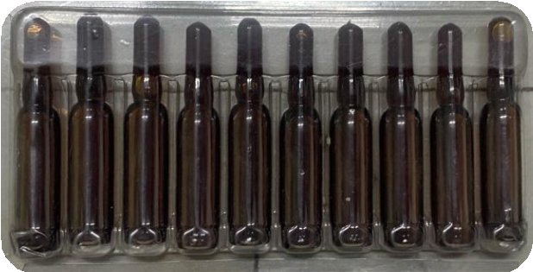
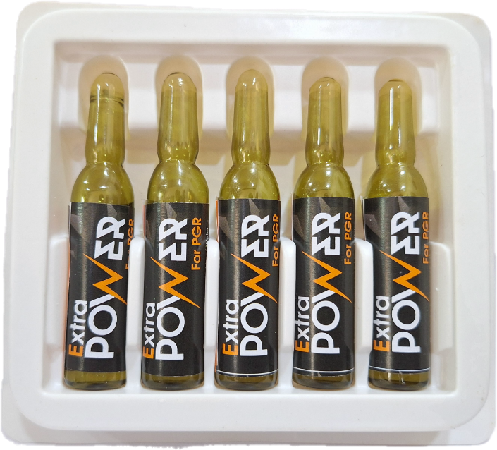
PGR 2ML
PGR (GIB)/5ML
PGR
Packing :
2 ML X 10 Nos = 1 Tray
(100 Tray X 1 Box)
(250 Tray X 1 Box )
Dose :
2 ml /15 liter water
Use :
Increases seed germination Increases flowering and fruiting Increase crop quality and yields
PGR (GIB)
Packing :
5 ML X 5 Nos = 1 Tray
(100 Tray X 1 Box)
Dose :
5 ml / 15 liter water
Use :
Provides better cell devisions.
Cell enlargement it helps in branching and flowering Increases fruit quality and yields
Increases size, taste and colour of fruits

Slide 5
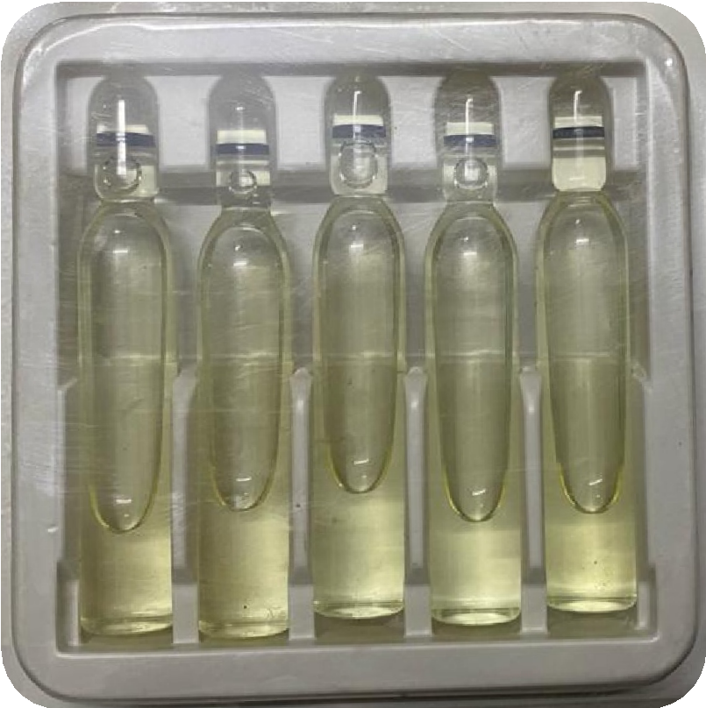
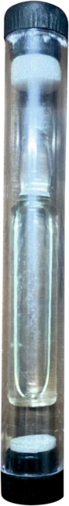
PGR (6BA)/5ML
PGR (GIB)
10ML DONGLE PACK
PGR (6BA)
Packing :
5 ML X 5 Nos = 1 Tray
(100 Tray X 1 Box)
Dose :
5 ml / 15 liter water
Use :
Provides better cell devisions.
Cell enlargement it helps in branching and flowering Increases fruit quality and yields
Increases size, taste and colour of fruits
PGR (GIB)
Packing :
10 ML Dongle Pack (500 Dongle X 1 Box)
Dose :
10 ml / 100 liter water
Use :
Provides better cell devisions.
Cell enlargement it helps in branching and flowering Increases fruit quality and yields
Increases size, taste and colour of fruits

Slide 6
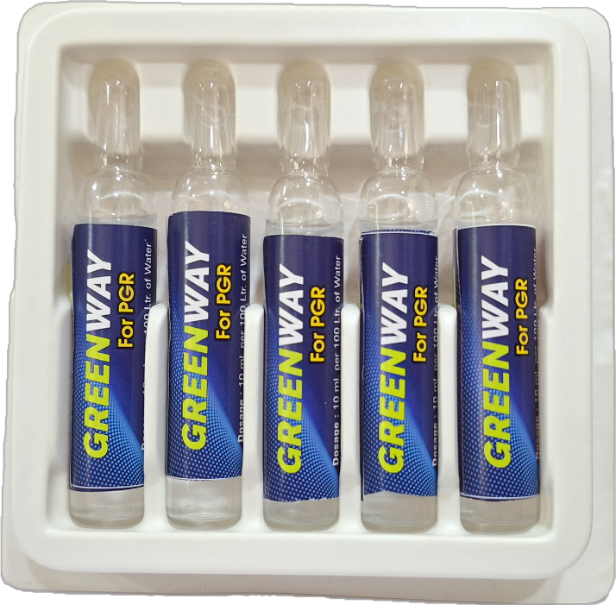
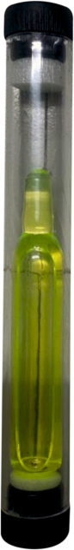
PGR (6BA)
10ML DONGLE PACK
PGR (6BA) 10ML
PGR (6BA)
Packing :
10 ML X 5 Nos = 1 Tray
(100 Tray X 1 Box)
Dose :
10 ml / 100 liter water
Use :
Provides better cell devisions.
Cell enlargement it helps in branching and flowering Increases fruit quality and yields
Increases size, taste and colour of fruits
PGR (6BA)
Packing :
10 ML Dongle Pack (500 Dongle X 1 Box)
Dose :
10 ml / 100 liter water
Use :
Provides better cell devisions.
Cell enlargement it helps in branching and flowering Increases fruit quality and yields
Increases size, taste and colour of fruits

Slide 7
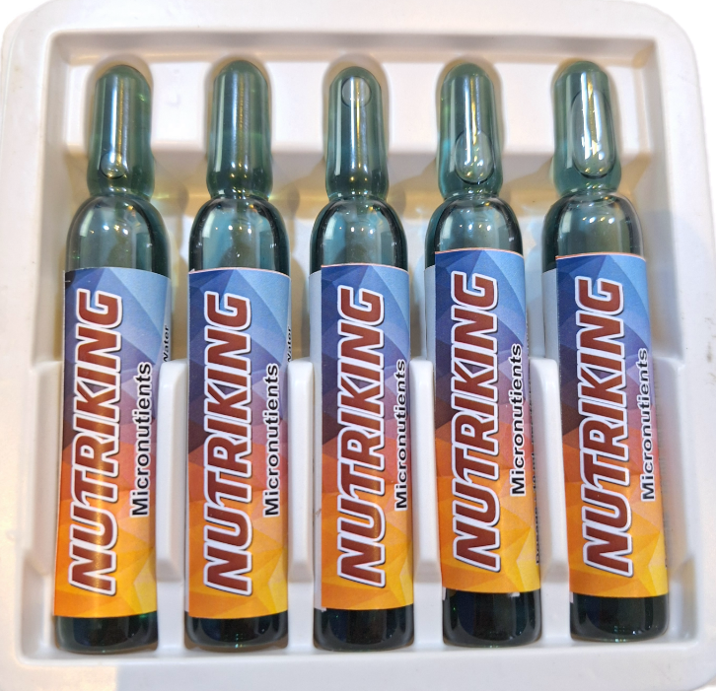
PGR (GIB)/10ML
MIX MICRO NUTRIENTS
PGR (GIB)
Packing :
10 ML X 5 Nos = 1 Tray
(100 Tray X 1 Box)
Dose :
10 ml / 100 liter water
Use :
Provides better cell devisions.
Cell enlargement it helps in branching and flowering Increases fruit quality and yields
Increases size, taste and colour of fruits
MIX MICRONUTRIENTS
Packing :
10 ML X 5 Nos = 1 Tray (100 Tray X 1 Box) Dose :
10 ml / 15 liter water
Use :
Maintain the all nutrient balance in plant make plant healthier and decrease the atomsphere stress
Increase the enzyme balance in plant and growth of overall plant
Increases fruit quality and yields
Increases size, taste and colour of fruits

Slide 8
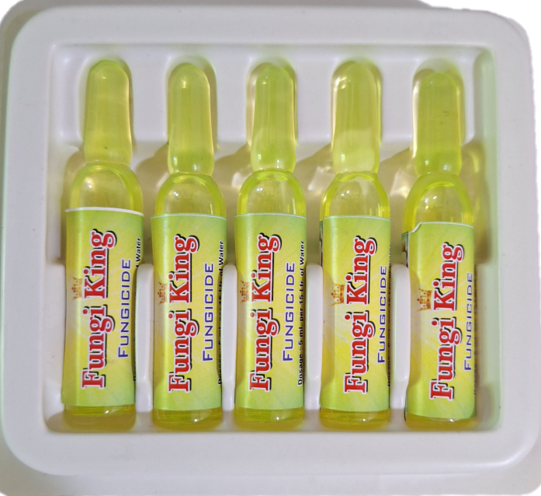
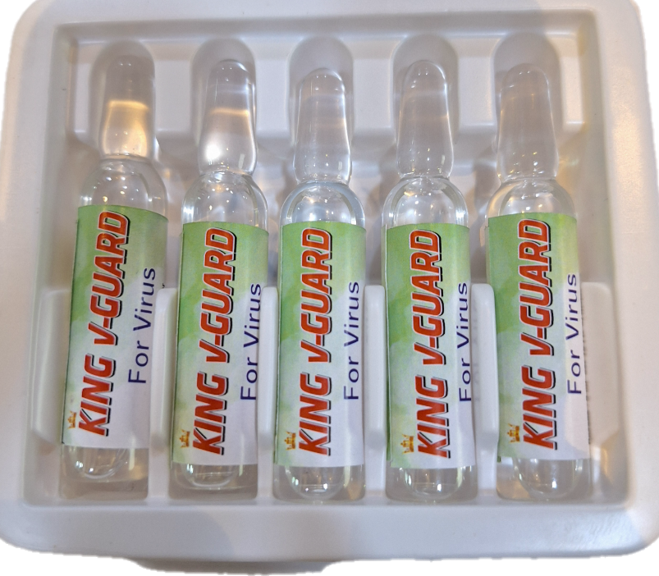
FUNGICIDE
VIRICIDE
FUNGICIDE
Packing :
5 ML X 5 Nos = 1 Tray
(100 Tray X 1 Box)
Dose :
5 ml / 15 liter water
Use :
used against downy mildew, powdery mildew, grey mildew used against early bright, anthracnose, leaf spot, mosaic improve plants growth and crop quality
VIRICIDE
Packing :
5 ML X 5 Nos = 1 Tray
(100 Tray X 1 Box)
Dose :
5 ml / 15 liter water
Use :
Used against all types viruses and bacteria in plant used against early bright, leaf spot, mosaic and leaf curl improve plants growth and crop quality

Slide 9
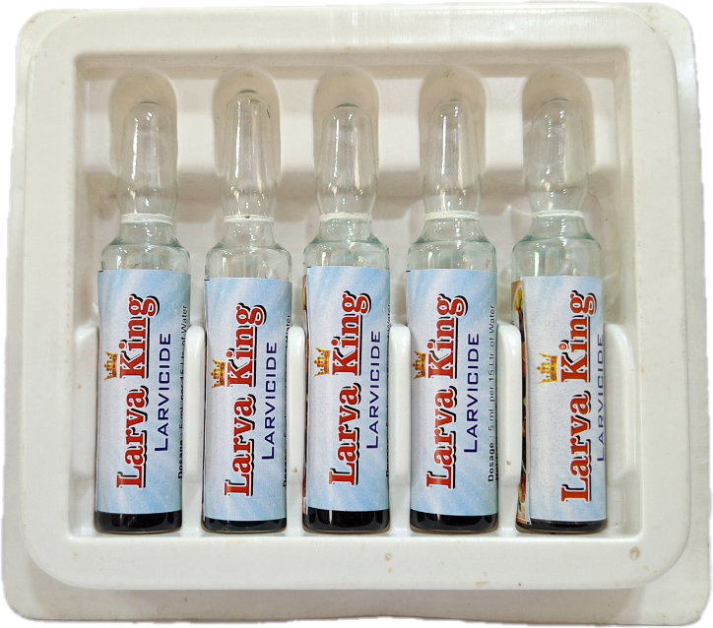
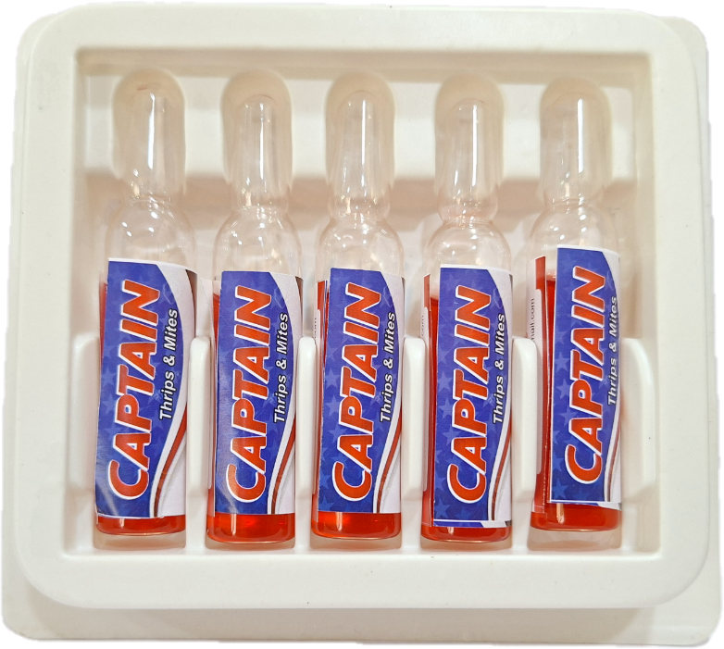
LARVICIDE
MITYCIDE
Larvicide
Packing :
5 ML X 5 Nos = 1 Tray
(100 Tray X 1 Box)
Dose :
5 ml / 15 liter water
Use :
Effective against Larva it has a toxic effect on eggs of some species and, in some cases, reduces fecundity it make plant healthier and decrease the insect stress
MITYCIDE
Packing :`
5 ML X 5 Nos = 1 Tray
(100 Tray X 1 Box)
Dose :
5 ml / 15 liter water
Use :
It control of sucking and chewing insects,
such as thripes, mites, jassid and aphides. it make plant healthier and decrease the insect stress

Slide 10
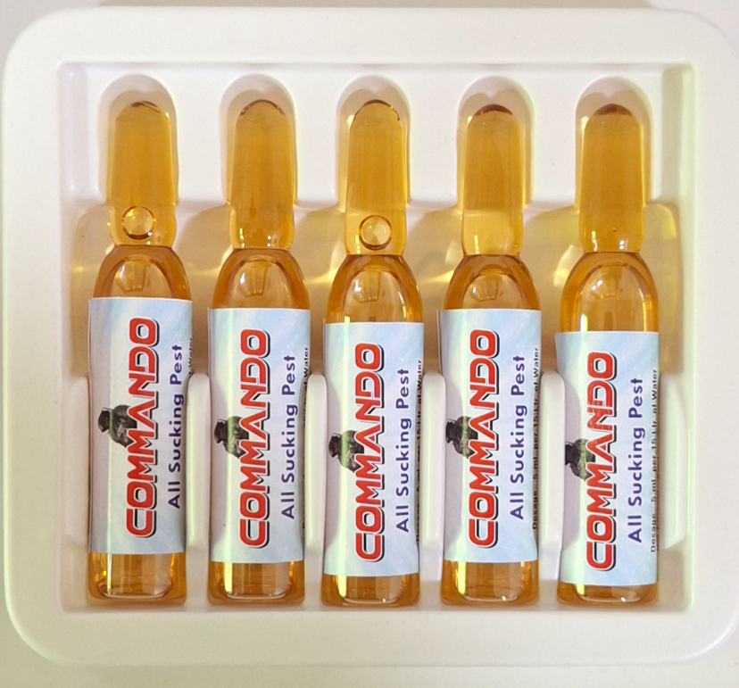
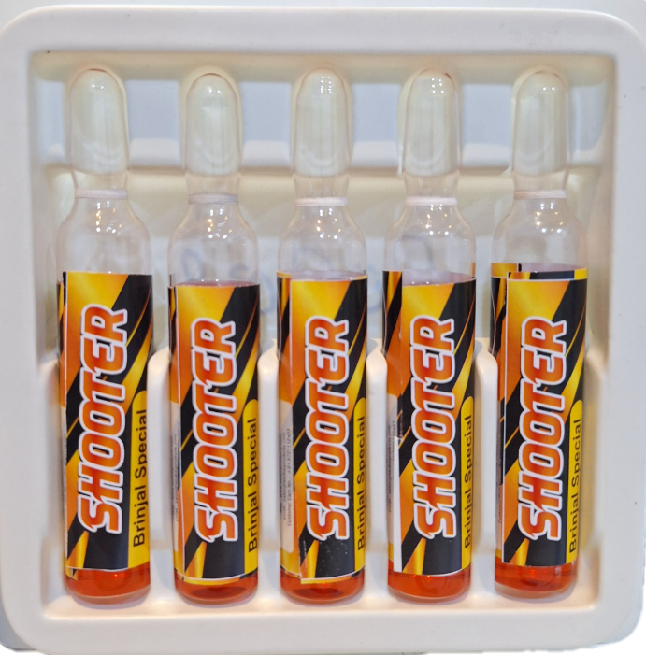
ALL SUCKING PEST
BORER SPECIAL LARVICIDE
ALL SUCKING PEST
Packing :
5 ML X 5 Nos = 1 Tray
(100 Tray X 1 Box)
Dose :
5 ml / 15 liter water
Use :
Control of sucking and chewing insects, such as plant hoppers, stink bugs Effective against Larva, Aphids and whiteflies it make plant healthier and decrease the insect stress
BORER SPECIAL LARVICIDE
Packing :
5 ML X 5 Nos = 1 Tray (100 Tray X 1 Box)
(CORN/BRINJAL/BORER SPECIAL )
Dose :
5 ml / 15 liter water
Use :
Effective against stem borer, shoot borer and all types of borer larvait has a toxic effect on eggs of some species and, in some cases, reduces fecundity it make plant healthier and decrease the insect stress

Slide 11
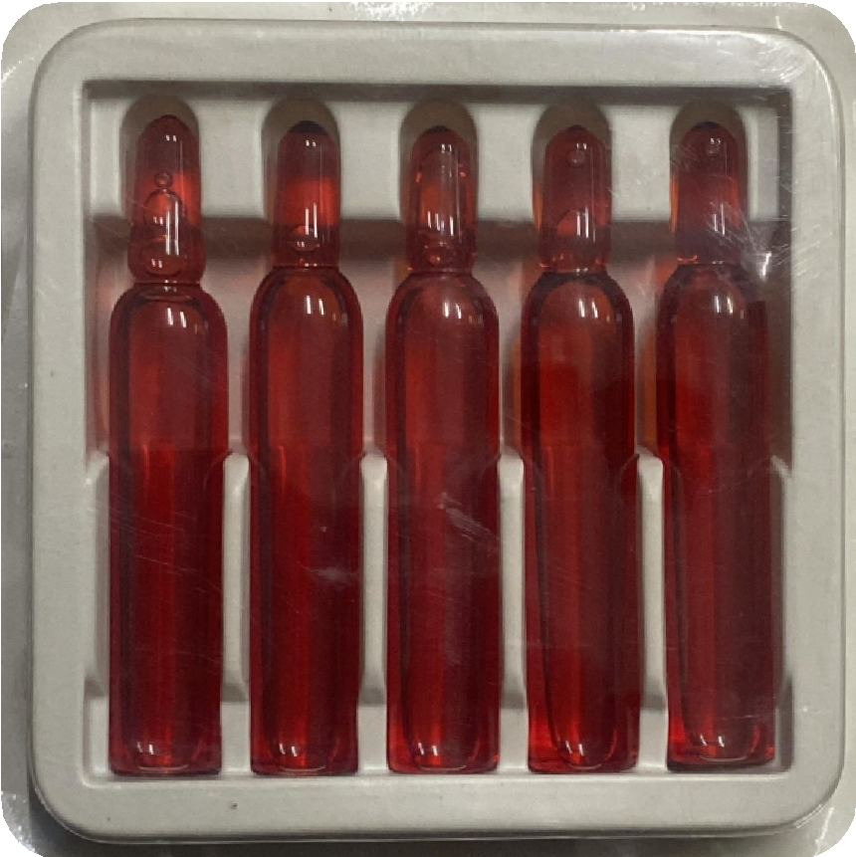
ALL TYPES OF LARVA
ALL TYPES OF LARVA
Packing :
10 ML X 5 Nos = 1 Tray (100 Tray X 1 Box)
(CORN/BRINJAL/BORER SPECIAL )
Dose : 10 ml / 15 liter water
Use :
Effective against all types of larva likes sucking larva, borer larva it has a toxic effect on eggs of some species and, in some cases, reduces fecundity it also effective against inside flowering and fruiting larva specially brinjal, corn and cotton it make plant healthier and decrease the insect stress

Slide 12





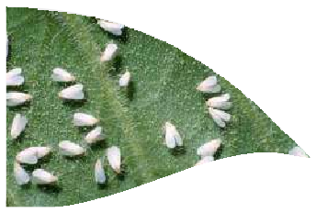
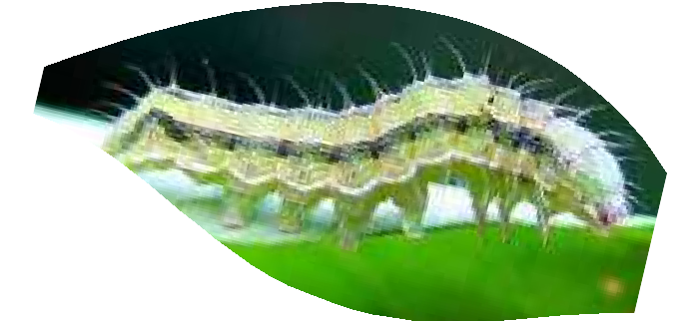


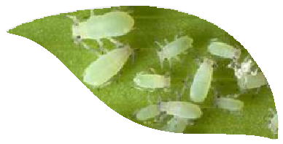


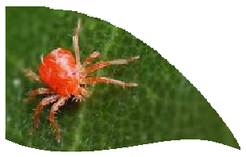
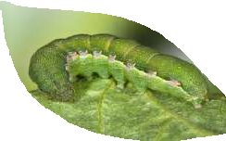


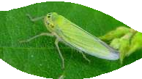
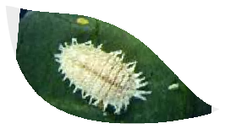
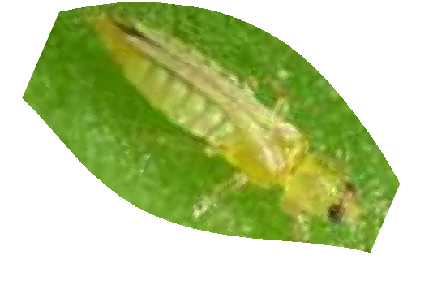





Red. Office. 14/4 Corner, Atika Industrial Area, Banshidhar Chowk, Rajkot – Gujarat -360003
Email: kingagrochemicals@gmail.com
Contact us: +91 80000 7779/+91 80000 14151

